Slide 1

G5Fly integration with NXP

Slide 2


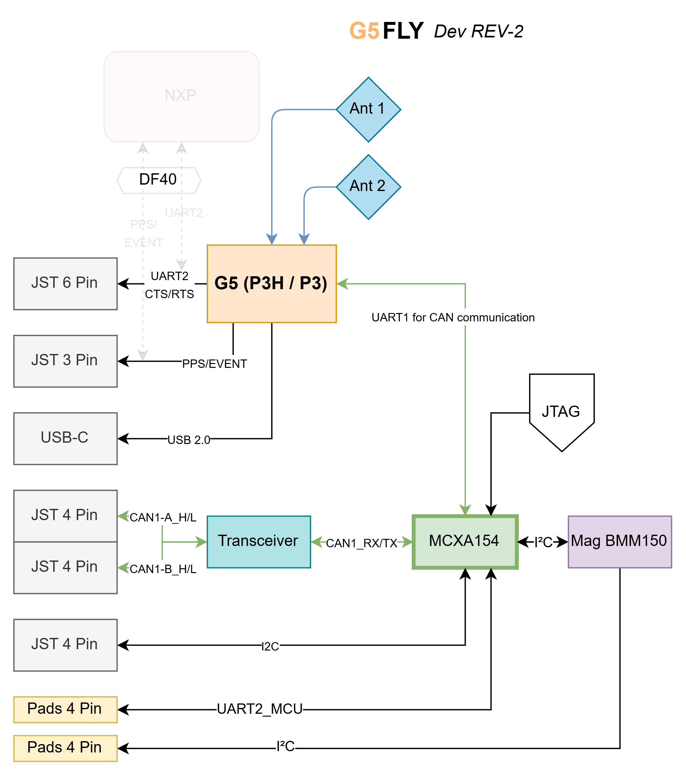
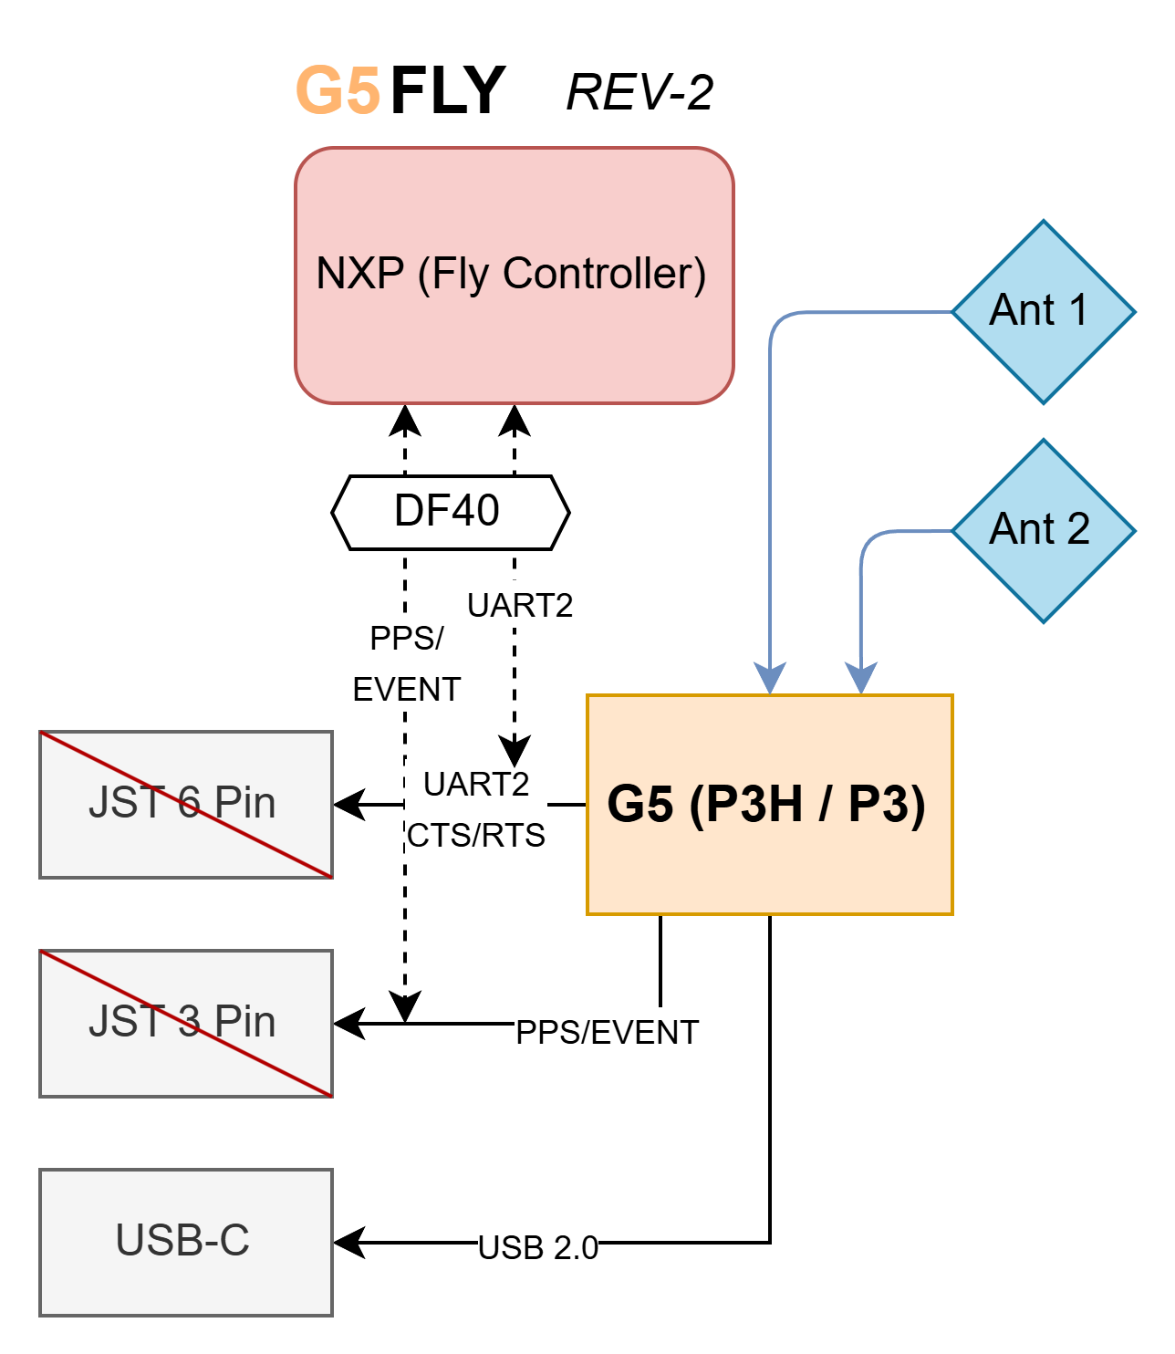
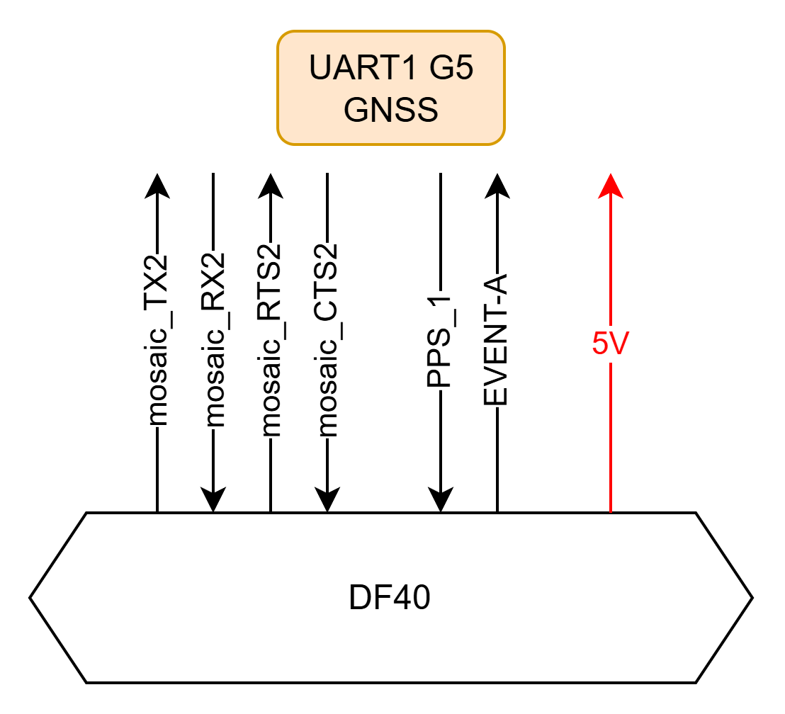
Hardware Integration with NXP
FPV GNSS based on NXP MCU
GNSS Tool for NXP MR-MCXN-T1 Hub
Unmonted component for MR-MCXN-T1 Hub

Slide 3
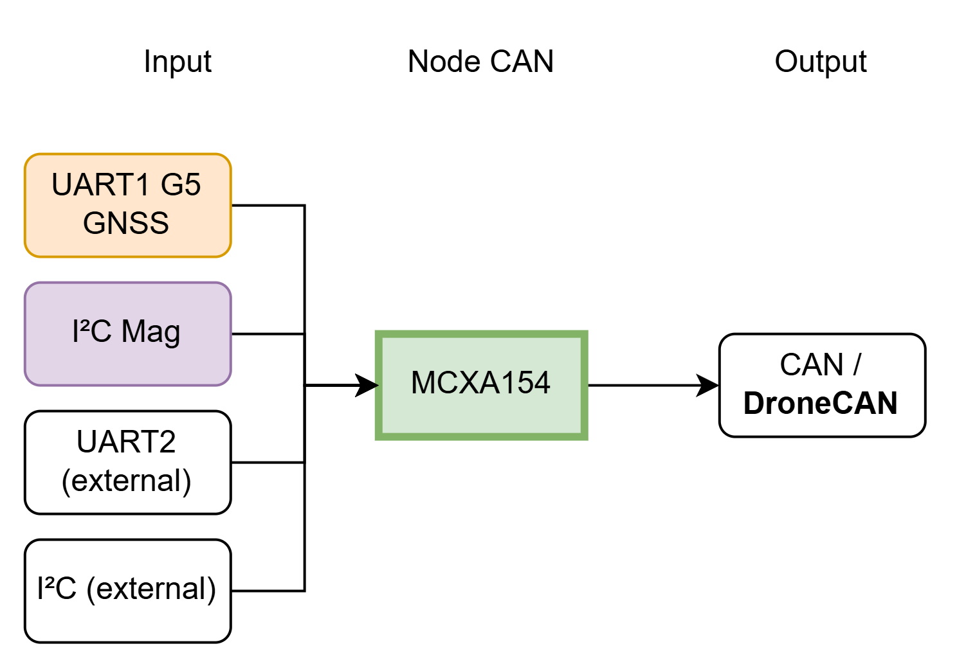
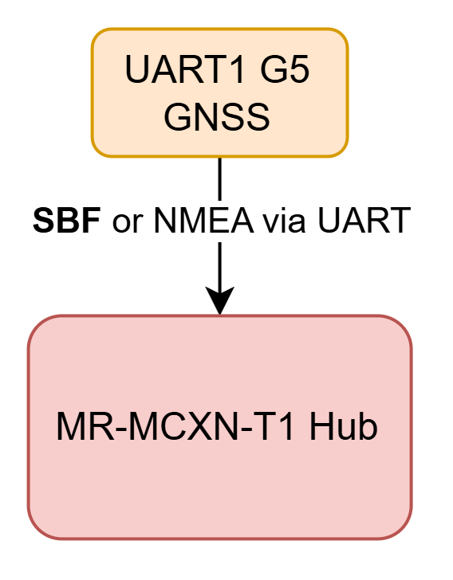
Software Integration with NXP
FPV GNSS based on NXP MCU
GNSS Tool for NXP MR-MCXN-T1 Hub
Need software capable of managing DroneCAN with SBF or NMEA + I²C Mag + other possible sensor inputs
Need software capable of managing SBF or NMEA via UART

Slide 4
Recap: Data Flow using AP_Periph
Protocol of choice (UART,USB,etc.)
DroneCAN
Connected to all other peripherals
Peripheral
MCU running AP_Periph
Flight Controller
such as Mosaic G5

